Slide 1

predicting post-operative length of stay
Using machine learning to improve care and improve utilization
Jamie Lepard
Product Strategy, Health Futures
November 10th, 2023

Slide 2












PROBLEM STATEMENT illustrated:
What if we could predict this day much earlier?
Immediately following surgery
Illustrations:
Liz Lamb
transfer to ward
care pathway
discharge plan
home
waiting...
surgery
recovery
No beds post-op means cancelled surgery
There are a limited number of beds
Patients need to be discharged so more get care

Slide 3
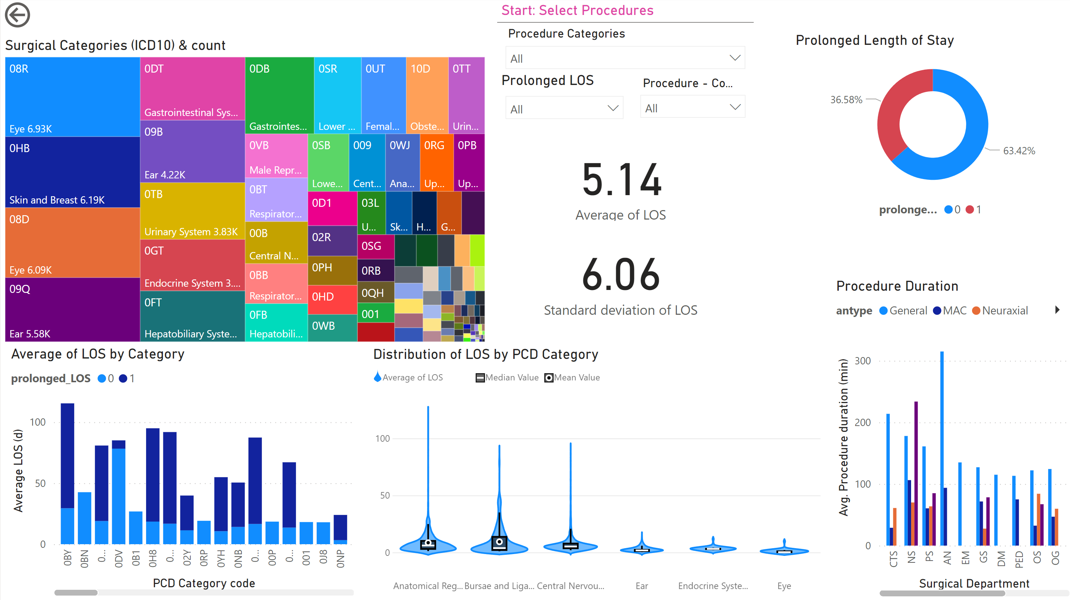
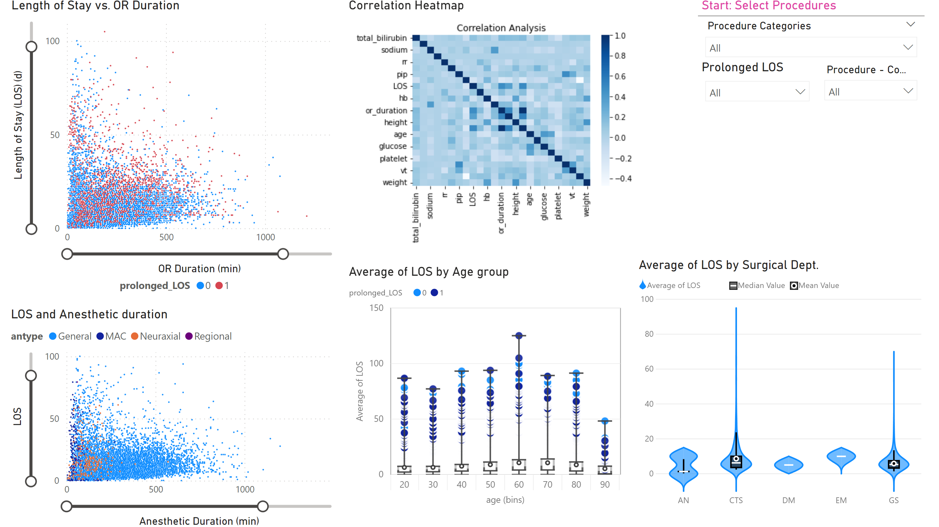
OPPORTUNITY
Objective:
Apply various machine learning models to predict the length of stay (LOS) or if the patient is at risk of a prolonged stat (PLOS)
Dataset:
INSPIRE dataset is a publicly available research dataset in perioperative medicine
Approximately 130,000 surgery cases in South Korea between 2011 and 2020.
Patient characteristics such as age, sex, physical status classification, diagnosis, surgical procedure code, department, and type of anesthesia
Data set includes vital signs in the operating theatre, general wards, intensive care units (ICUs) & laboratory results.

Slide 4
APPROACH
Data Engineering:
Filter lab and vital results (>4.5M) to those most proximal to surgery end time.
Join and transform three tables to a single table for machine learning pipeline
Feature Engineering:
Impute null values for vitals/labs. Grouped subjects by age, race, and sex to impute value.
Convert timestamps to durations (procedure, anesthetic, length of stay)
Categorize ICU visit (y/n) and Prolonged LOS (y/n) *
Model Selection
Categorization or Regression model– why not both?!
Selected models: linear/logistic regression, Random Forest ExtraTrees, XGBoost, CatBoost
Training, validation, test split (80:20:20)
Parameter tuning via grid search
Evaluation
* Length of stay was deemed ‘prolonged’ if LOS was greater than 1 standard deviation of mean in the PCD category

Slide 5

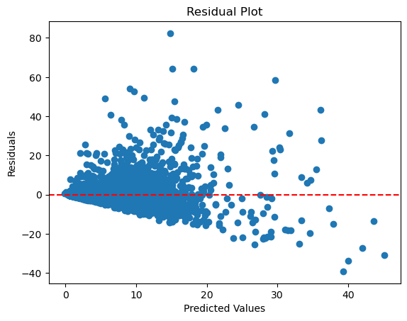
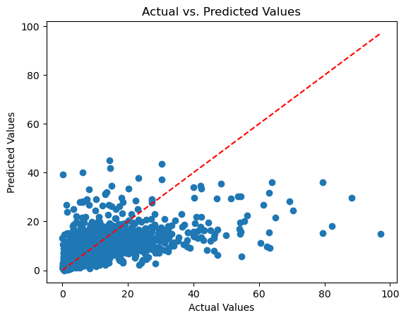
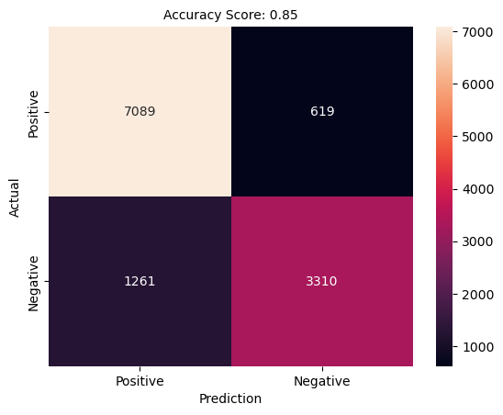
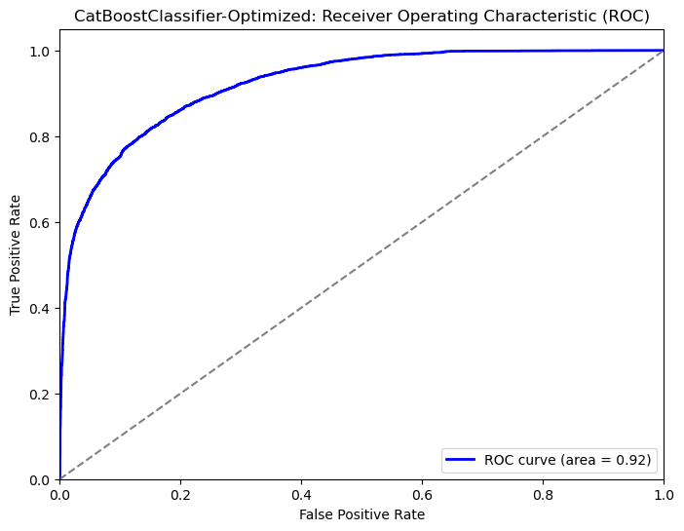
RESULTS
Regression Models:
Categorization Models
Model | R-squared | RMSE
Linear Regression | -29046 | 9515250466
Random Forest | 0.49 | 3.99
Extra Trees | 0.48 | 4.03
XGB | 0.49 | 4.00
CatBoost - Optimized | 0.52 | 3.884
Model_Name | Sensitivity | Specificity (recall) | Accuracy
Logistic Regression | 0.649092 | 0.928775 | 0.82
CatBoost Classifier | 0.732444 | 0.912169 | 0.85
CatBoost Classifier-Optimized | 0.724130 | 0.919694 | 0.85
CatBoost model selected for both Regression and Classification models
Regression: R² of 0.52, meaning the model can accommodate 52% of the variation observed (not great)
Classification: Specificity of 92% meaning model appropriately identifies 92% who were prolonged LOS. But the
model also has Sensitivity of 72%, ie. it ‘misses’ ~30% of patients who will turn out PLOS.

Slide 6

Next steps
Increase training data set – additional databases include MIMIC, PMSI, HiRID, AUMC
Introduce neural network as additional modelling strategy
Deploy models to Azure and develop front-end interface
Engage hospital leadership to validate PLOS criteria.
Augment binary PLOS (y/n) to ‘bins’ (0-2 days, 2-4 days, 4-7 days, etc)
Jamie Lepard
Product Strategy, Health Futures
November 10th, 2023
LinkedIn | GitHub

